Slide 1
MutaCraft
Hybrid ‘Seed + De Novo’ Binder Generation

Slide 2
MutaCraft Rationale
De novo binder generation can be costly as it generates random binders, can drift away from designs that can actually exist in the real world
Pure Mutational binder generation may not explore global minimum
Hybrid approach to get the best of both worlds:
Preserve trusted residues to save computation, while keeping random exploration to find global min

Slide 3
MutaCraft Procedure
User inputs Target Protein and Template Binder
MutaCraft masks subset of residues in Template Binder to preserve them
Perform 4-stage AlphaFold2 optimisation passes
Evaluate and keep best binders

Slide 4
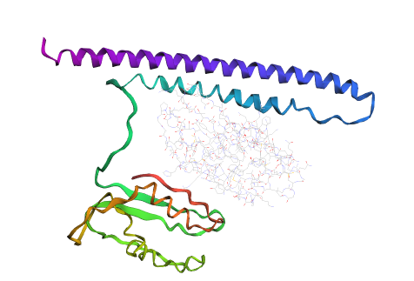
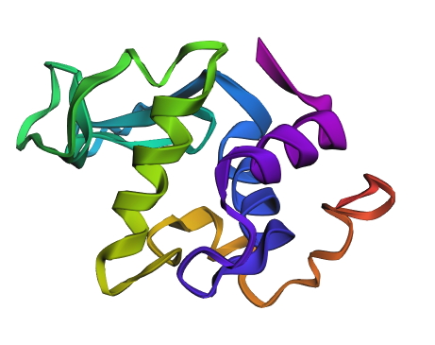
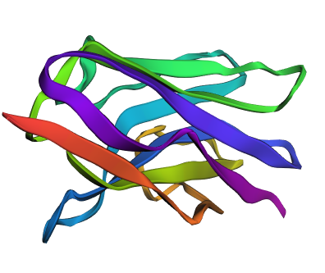
Test Run: Human Lysozyme Binder
1OP9.pdb: Complex of human lysozyme with camelid VHH HL6 antibody fragment
Target protein: Human lysozyme
Binder template: HL6
I tested MutaCraft by letting it generate mutants using HL6 as the seed, then evaluated them
Target: Lysozyme
Binder Template: HL6
My MutaCraft generated Binder

Slide 5
Results (Scored using AF & Rosetta)
Binder | plddt_mean Higher is better | ptm_mean Higher is better | i_ptm_mean Higher is better | pae_mean Lower is better | i_pae_mean Lower is better | loss_mean Lower is better
HL6 camel VHH template (Original Binder) | 0.397544 | 0.439117 | 0.154836 | 0.766483 | 0.881567 | 6.450178
Best MutaCraft Binder | 0.494419 | 0.44309 | 0.155191 | 0.761355 | 0.853633 | 5.961434
Improvement Percentage | 24.3%☑ | 0.9%☑ | 0.22%☑ | 0.669%☑ | 3.2%☑ | 7.6%☑
MutaCraft’s binder shows Improvement across all metrics:
pLDDT (predicted Local Distance Difference Test): Binder residue-level confidence
pTM (predicted TM-score): Confidence in the binder’s global fold
i_ptm: pTM at Interface (where target and binder meet)
pAE (predicted Alignment Error): Positional error between target and binder
i_pAE: pAE at Interface
AlphaFold loss: Aggregate design objective used during optimisation

Slide 6
Results
Why the hybrid design pulls ahead:
Seed-guided initialisation preserved HL6 hotspot contacts
The KL prior kept them stable during Stage 1
Semi-greedy mutations repaired low-confidence loops
Resulting in: Confidence up and Error down

Slide 7
Future Improvements
Reinforcement learning loops:
Introduce policy-gradient or RL fine-tuning where mutation proposals are rewarded with AlphaFold confidence/interface metrics.
Learn which mutations consistently improve binding instead of following fixed schedules.
Evolutionary / genetic refinement:
Maintain good binders, recombine guided/unguided regions, apply targeted mutations to carry forward useful changes. Avoid discarding partial successes when restarts happen.
Benchmark MutaCraft vs BindCraft cost:
See if MutaCraft is less computationally demanding/faster than BindCraft

Slide 8
Mutacraft Hybrid Binder Design
Mutacraft implements a hybrid binder design workflow that couples AlphaFold2 structure refinement with semi-random sequence exploration to iteratively improve binders against a chosen target.
The workflow is most useful when a template binder exists; it preserves trusted residues while still probing new sequence space, reducing risk compared to purely de novo designs.

Slide 9
Why Hybrid?
Pure de novo hallucination offers maximum freedom but can drift away from experimentally validated scaffolds, leading to unstable binders or loss of key contacts.
Pure transplanting of a known binder explores too narrowly; it rarely discovers improved interface contacts or tighter binding interactions.
The hybrid strategy keeps a controllable fraction of residues near the seed while allowing AlphaFold2 to explore novel positions, capturing the strengths of both extremes.
Case study: camelid VHH HL6 fragment (chain A of PDB 1OP9) targeting human lysozyme (chain B).

Slide 10
Inputs & Layout
InputTargets/ stores both the receptor (`HumanLysozyme.pdb`) and the template binder (`HL6_camel_VHH_fragment.pdb`), so paths are edited once in the configuration cell.
Each run writes outputs to Results/MutaCraft/<run_name>/ (e.g., `HL6_VHH_run`), keeping FASTA, PDB, and metrics.csv grouped per experiment.
AlphaFold2 weights are loaded from `bindcraft/params/`, eliminating repeated downloads and ensuring consistent model availability.
Notebook controls let you specify binder/target chains, guided fraction, KL settings, and iteration counts without modifying ColabDesign internals.

Slide 11
Workflow Overview
Extract the template sequence from selected chains and trim/pad it to match the binder slot that AlphaFold dynamically allocates (the notebook prints both requested and actual lengths).
Construct the guided mask and hybrid logits so seed-protected residues remain template-biased while the remaining positions start from diversified logits.
Run the four staged AlphaFold2 optimisation passes (logits, softmax anneal, straight-through, semi-greedy) to sculpt the candidate binder sequence.
Collect metrics, track the best-performing sequences, and write outputs for downstream evaluation or experimental design.

Slide 12
Hybrid Initialisation
`guided_mask` randomly marks a user-defined fraction of residues (default 50%) as protected; these positions start near the template and receive KL regularization early on.
`alpha_schedule` decays from 0.9 to 0.2 across Stage 1, gradually handing control from the template to exploratory sampling.
`init_mixed_logits` blends seed logits with Gaussian noise so protected residues remain near the template and free residues start de novo.
An optional KL prior keeps guided positions close to the seed in the first iterations and then tapers off to enable exploration once confidence increases.

Slide 13
Stage 1: Logits Refinement
Stage 1 includes 50 base iterations plus 25 extra logits refinements, during which the seed/noise blend is optimized via AF2 gradients.
Callbacks before and after each AF2 step respectively re-blend logits with the seed and apply KL gradients when enabled, keeping guided residues anchored early in training.
Per-iteration metrics (loss, interface contact scores, pLDDT) are logged, and a counter displays Stage 1 progress directly in the notebook output.

Slide 14
Stages 2 & 3
Stage 2 performs a 45-step temperature anneal from 1.0 to 0.05, sharpening amino-acid probabilities and encouraging decisive residue selection at each position.
Stage 3 follows with five straight-through (hard) steps at a low temperature (1e-2), effectively locking in discrete amino acids while still leveraging AF2 gradients.
The notebook pins AlphaFold to model index 0 and uses `num_models=1`, `sample_models=False` for reproducible behavior across runs.

Slide 15
Stage 4: Semi-greedy
Stage 4 executes a semi-greedy search: mutate roughly 5% of the binder positions per proposal, optionally biasing guided residues toward the seed amino acid.
Each candidate mutation is evaluated using `model.predict(..., models=[0])`, providing a fresh AF2 auxiliary dictionary before comparing losses.
The best candidate per iteration replaces the current sequence, metrics are updated, and a counter logs accepted losses and stage progress.

Slide 16
Outputs
Upon completion, Mutacraft saves the best binder sequence (`best_binder.fasta`), the predicted binder-target complex (`best_complex.pdb`), and the full metrics table (`metrics.csv`).
Outputs are grouped under the configured run directory (e.g., `Results/MutaCraft/HL6_VHH_run/hybrid/`), keeping experiments isolated and reproducible.
Because the notebook is exploratory, no automatic acceptance filter is imposed—users review metrics or integrate external filters as needed.

Slide 17
Limits & Enhancements
ProteinMPNN integration is not yet included; adding a post-AF2 MPNN pass is a natural next step for sequence diversification.
Only model 0 is used currently. Future versions could reintroduce model ensembles, stricter acceptance filters, or a CLI for batch screening.
Further enhancements might include AlphaFold multimer protocols, automated scoring thresholds, or links into BindCraft’s full pipeline.

Slide 18
Takeaways
Adjusting the guided fraction, alpha schedule, and KL prior allows precise control over how much of the template is preserved versus reinvented.
The staged AlphaFold2 process plus semi-greedy refinement yields binders that remain structurally plausible while exploring new sequence variants, ready for further analysis or experimental follow-up.

